Slide 1
Generating Long and Informative Reviews with Aspect-Aware Coarse-to-Fine Decoding
Source: ACL’19
Speaker: Tzu-Yun, Chien
Advisor: Jia-Ling, Koh
Date: 2020/10/05

Slide 2
Outline
Introduction
Method
Experiment
Conclusion

Slide 3
Generating Reviews
$$(item: i)$$
$$(user: u)$$
$$x_{j,t}^{S}$$
$$(rating: r)$$
Generate
Review:
This microphone sounds surprisingly great . I did get this product fast through the mail . Price was what it would cost on the open market .

Slide 4
Generating Reviews
Problems:
RNN-based: Tend to generate short, repetitive and dull text.
GAN-based: Seldom consider the linguistic information
Focuses on word-level generation, neglecting the importance of topical and syntactic characteristics.

Slide 5
Motivation
Aspect:
Sound
Service
Price
Sketch:
This NN sounds RB great .
I VBD VB this product fast IN the NN .
Price was
WP it would cost on the JJ NN.
Review:
This microphone sounds surprisingly great . I did get this product fast through the mail . Price was what it would cost on the open market .

Slide 6
Aim(s)
Propose a review generation model by characterizing an elaborately designed aspect-aware coarse-to-fine generation process.
Decompose the generation process into three stages, namely aspect sequence generation, aspect-aware sketch generation and sketch-based sentence generation.

Slide 7
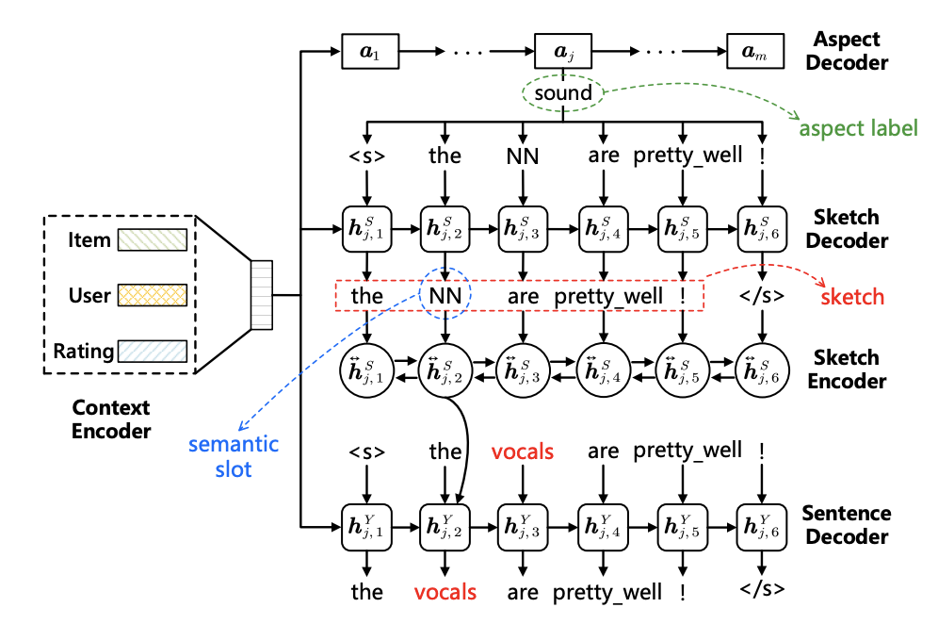
Framework

Slide 8
Context Encoder - Aspect Sequence Generation
Use a look-up layer to transform
$${Embedding of u, i, r: v}_{u}∈R^{d_{E}},v_{i}∈R^{d_{E}},v_{r}∈R^{d_{E}}$$
$$(item: i)$$
Produce a single vectorized representation
$$(user: u)$$
$$v_{c}={MLP([ v}_{u};v_{i};v_{r}]), { v}_{c}∈R^{d_{c}}$$
$$(rating: r)$$
summarizes the information from u, i, r

Slide 9
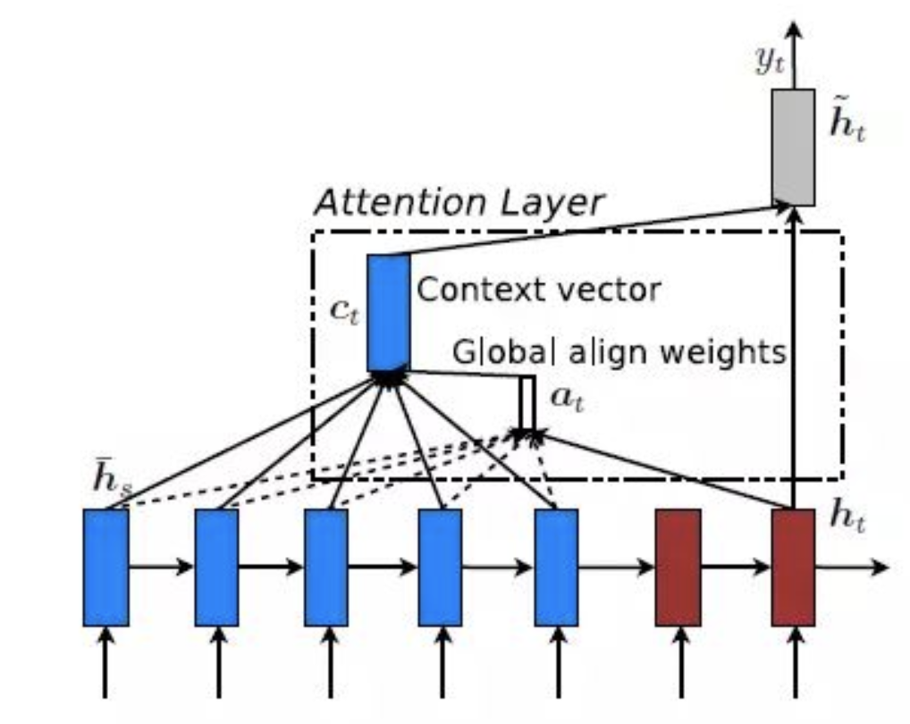
Aspect Decoder - Aspect Sequence Generation
GRU
Intitalized: $h_{0}^{A}= v_{c}$
$h_{j}^{A}=GRU(h_{j−1}^{A}, v_{a_{j −1}}^{})$
$$v_{c_{k}}$$
$$v_{c_{k}}$$
$$v_{c}$$
$$h_{j}^{A}$$

Slide 10
Aspect Decoder (Attention) - Aspect Sequence Generation
$$Pr⁡(a_{j}|a_{<j},c)$$
$$\tilde{h_{j}^{A}}$$
$w_{k}^{(t)}= \frac{exp⁡(\tanh\left(W_{1}\left[h_{t}^{A};v_{c_{k}}\right]\right)}{\sum_{c^{′}∈\{u, i,r\}}{exp⁡(\tanh\left(W_{1}\left[h_{t}^{A};v_{c_{k}}\right]\right))}}$
$$\tilde{c_{t}}$$
$$v_{c_{k}}$$
$$w_{k}^{(t)}$$
$\tilde{c_{t}}=\sum_{c_{k}∈\{u, i,r\}}{w_{k}^{(t)}v_{c_{k}}}$
$$v_{c_{k}}$$
$$v_{c}$$
$$h_{j}^{A}$$
$Pr⁡(a_{j}|a_{<j},c)=softmax(W_{4}\tilde{h_{j}^{A}}+b_{1})$
$\tilde{h_{j}^{A}}=tanh⁡(W_{2}\tilde{c_{j}}+ W_{3}h_{j}^{A})$

Slide 11
Sketch Decoder - Aspect-Aware Sketch Generation
Initialization,
$h_{1,0}^{S}= v_{c}$
$h_{j,0}^{S}=h_{j−1,n_{j−1}^{′}}^{S}$
$$h_{j,0}^{S}$$
$\operatorname{Pr}\left(s_{j,t} | {s_{j}}_{<t},a_{j},c\right)$
$$=softmax(W_{5}\tilde{h_{j,t}^{S}}+W_{6}v_{a_{j}}+b_{2})$$
$h_{j,t}^{S}=GRU(h_{j,t−1}^{S}, x_{j,t}^{S})$
$x_{j,t}^{}=v_{s_{j, t−1}^{}}^{}⨀{v_{a_{j}}}$

Slide 12
Sketch Encoder - Sketch-based Review Generation
Bi-directional GRU
$\overset{⃡}{h_{j,t}^{S}} =GRU(\overset{⃡}{h_{j,t}^{S}}, x_{j,t}^{S})$
$x_{j,t}^{}=v_{s_{j, t−1}^{}}^{}⨀{v_{a_{j}}}$

Slide 13
Sentence Decoder - Sketch-based Review Generation
$h_{j,t}^{Y}=GRU(h_{j,t−1, }^{Y}x_{j,t}^{Y})$
$x_{j,t}^{Y}=\overset{⃡}{h_{j,t}^{S}} ⨁{v_{y_{j},t−1}}$
$z=tanh⁡(W_{7}\left[\tilde{h_{j,t}^{Y};}v_{s_{j,t}}\right]+b_{3})$
$\operatorname{Pr}\left(y_{j,t} | {y_{j}}_{<t},s_{j,1:n_{j}^{′}},a_{j},c\right)$
$$=softmax(W_{5}z_{y_{j,t}}+θ_{y_{j,t}}^{a_{j}})$$

Slide 14
Dataset

Slide 15
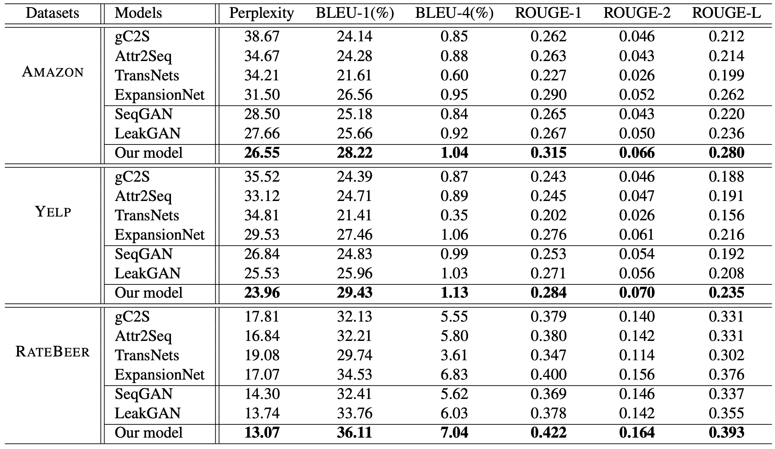
Performance comparisons of different methods

Slide 16
Ablation analysis

Slide 17
Aspect coverage evaluation

Slide 18
Fluency evaluation

Slide 19
Case Study

Slide 20
Conclusion
Proposed a novel review generation model using an aspect-aware coarse-to-fine generation process.
Decomposed the generation process into three stages focusing on different goals.

